Slide 1
Milwaukee
DENNIS K. WINTERS
Chief Economist
Wisconsin Department of Workforce Development

Slide 2

Be Careful

Slide 3

Gross Domestic Product

Slide 4
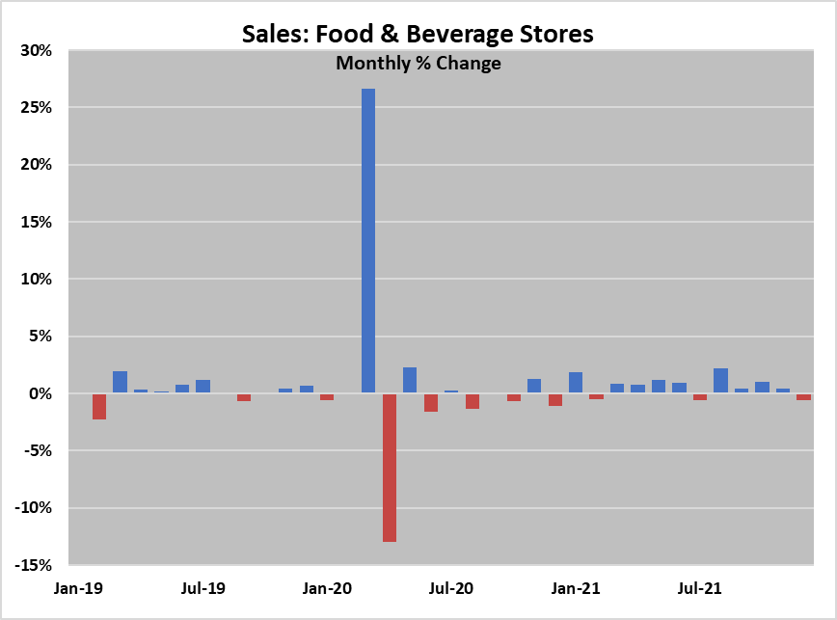
Sales, Food and Beverage Stores
Source: Advance Retail Sales: Food and Beverage Stores; BEA; FRED

Slide 5
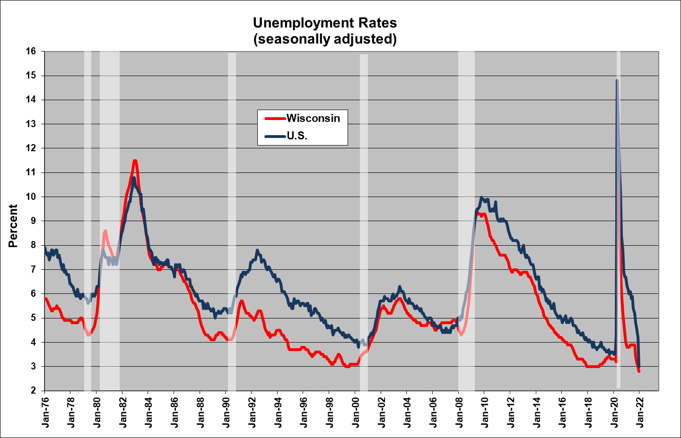
Unemployment

Slide 6
Employment

Slide 7
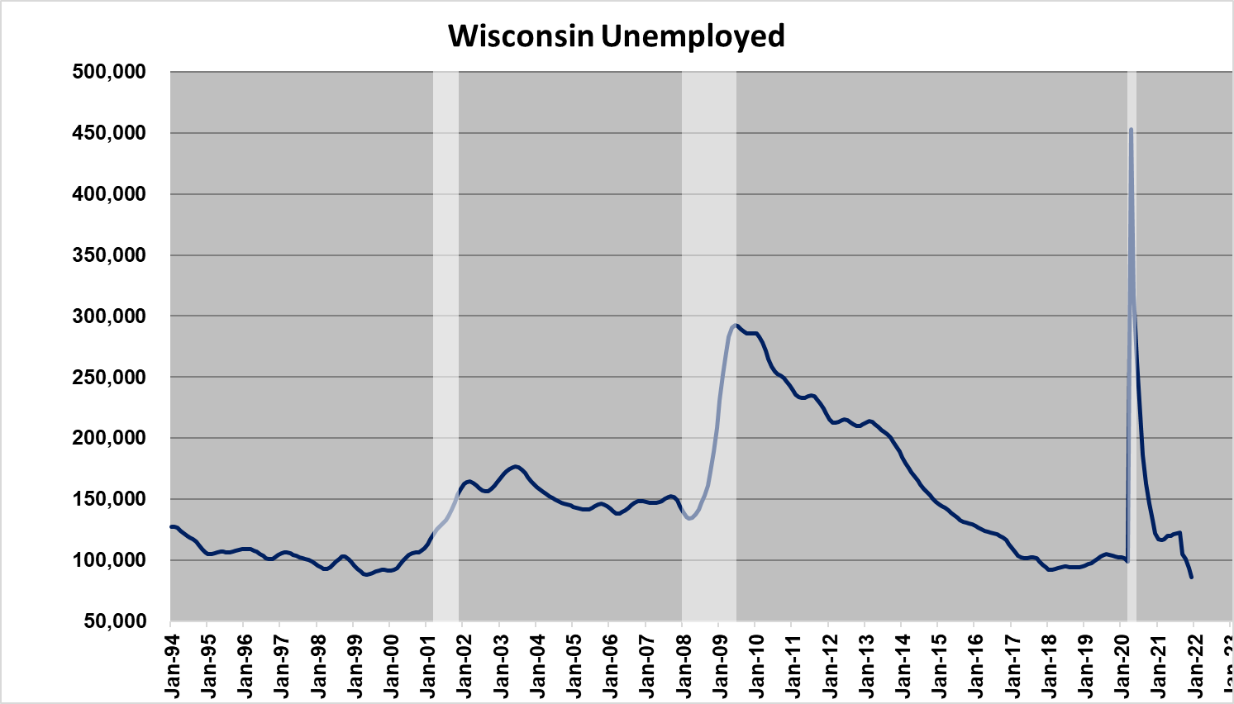
Unemployment

Slide 8
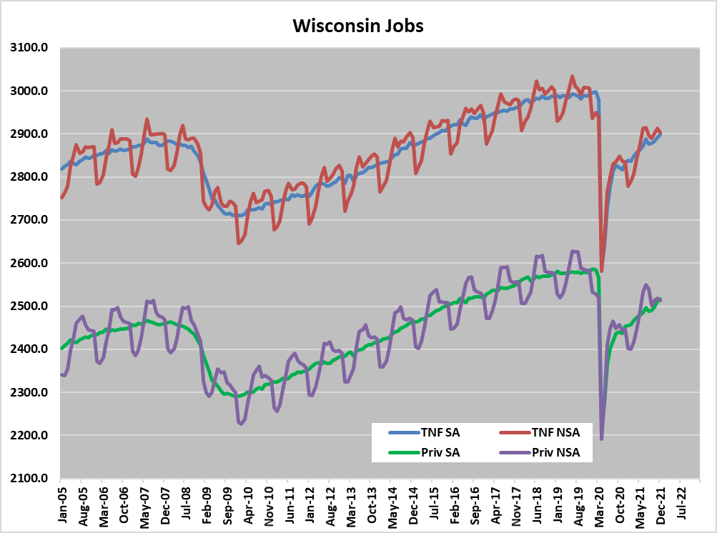
Wisconsin Jobs

Slide 9
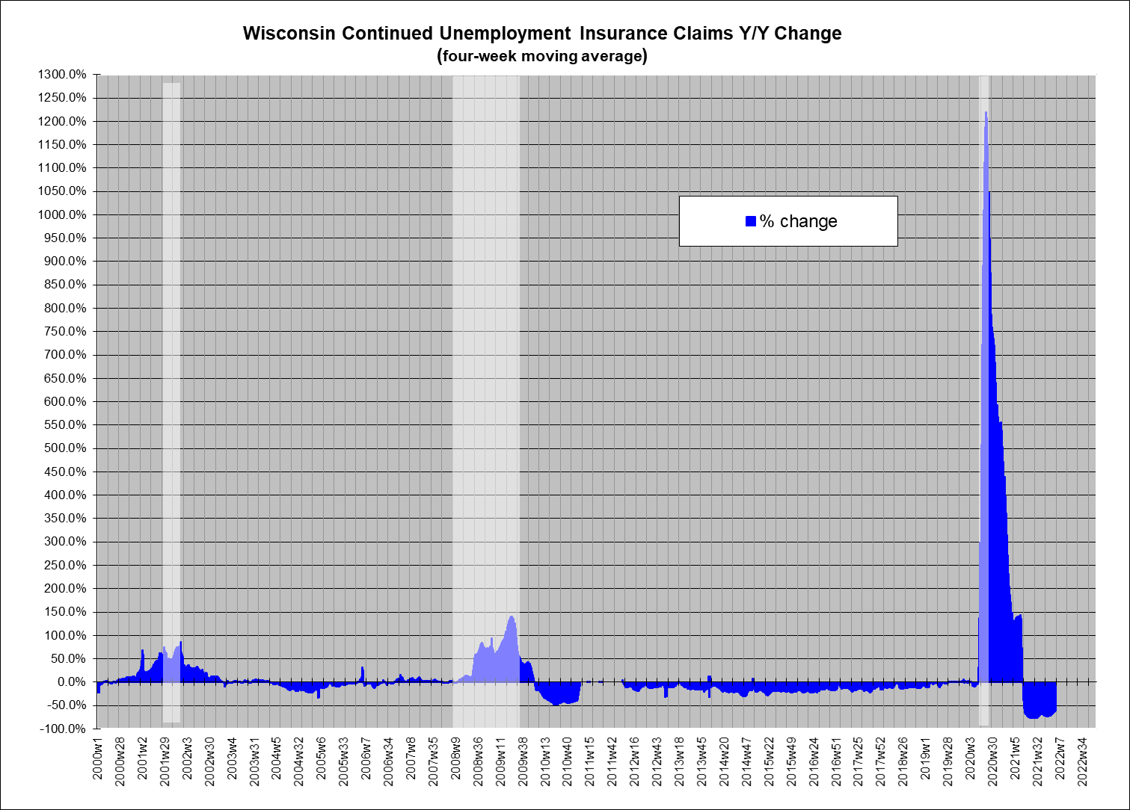

Slide 10
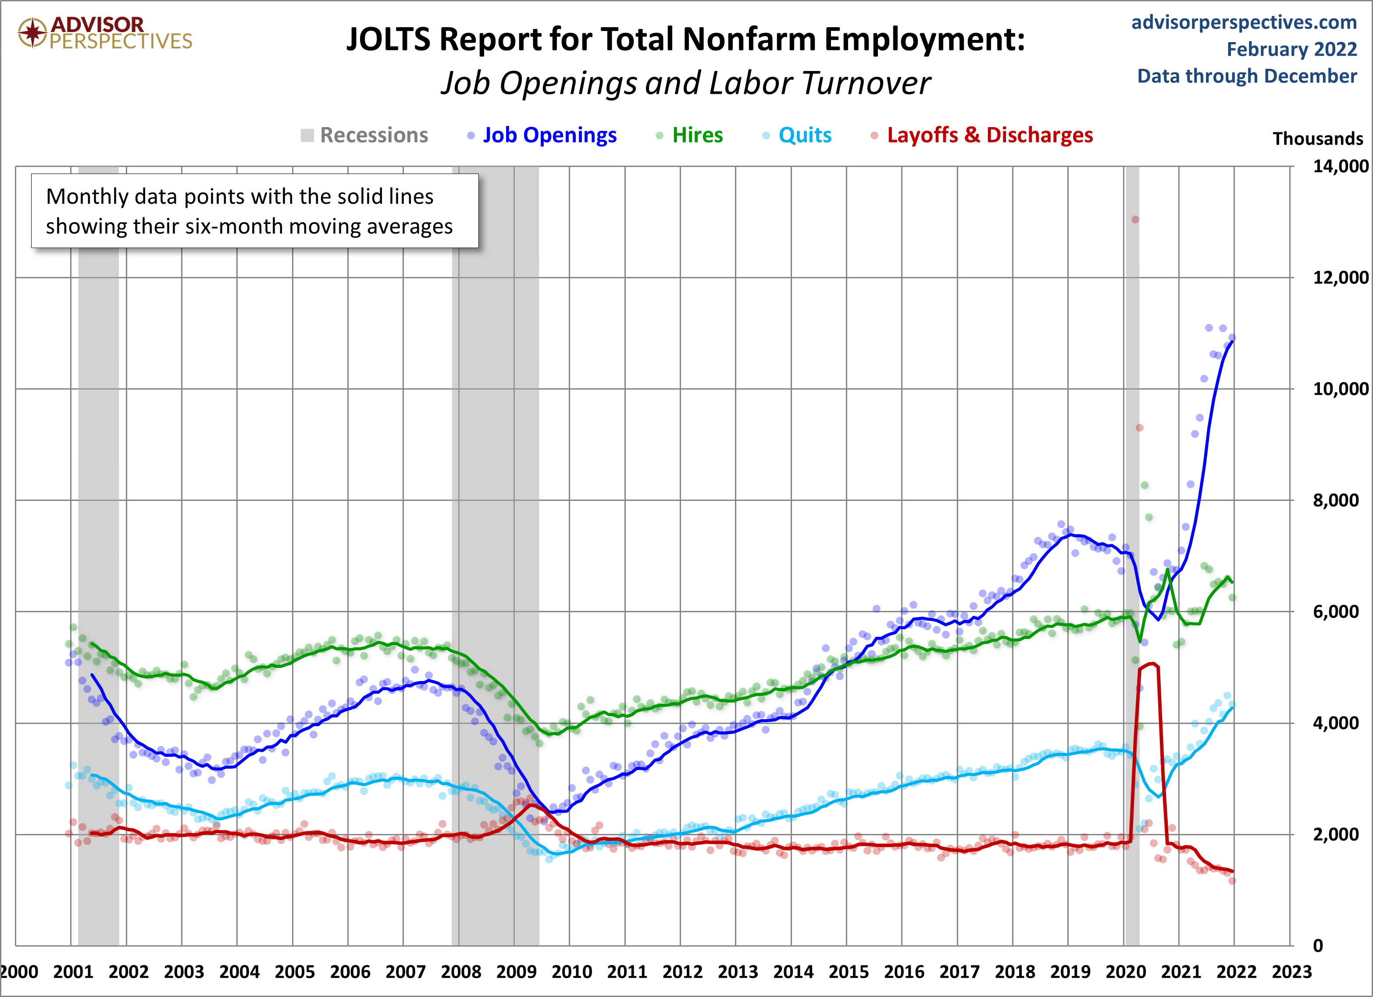
Employment Reactions

Slide 11
Employment Reactions
Source: BEA

Slide 12
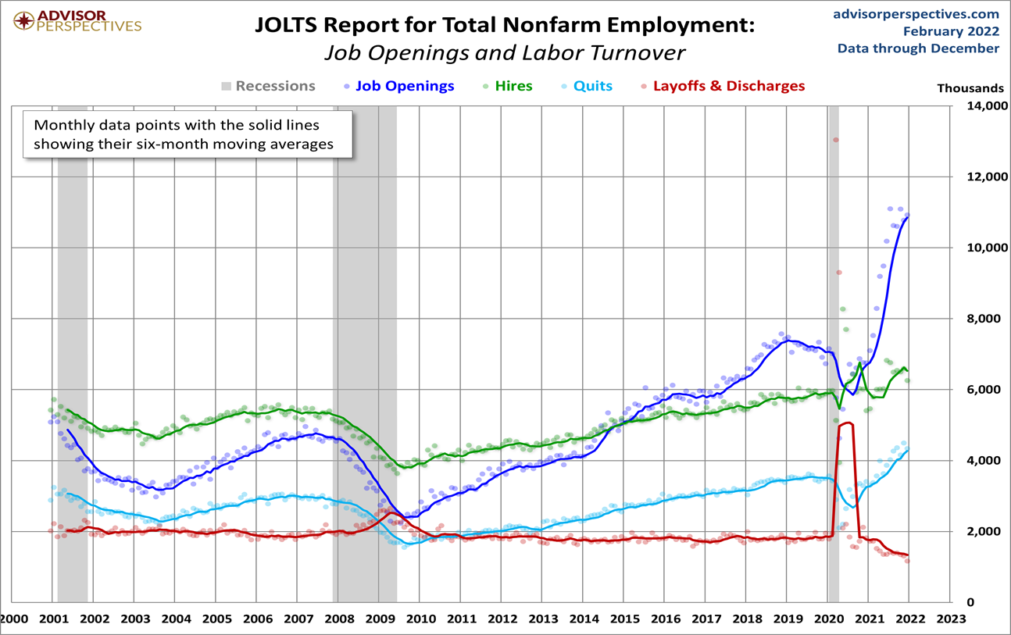
Employment Reactions

Slide 13
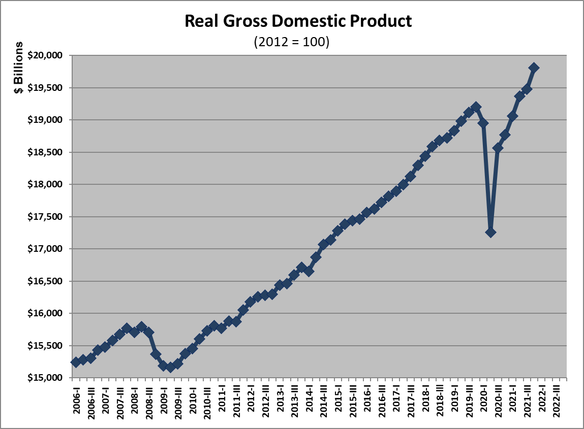
Gross Domestic Product
Source: BEA

Slide 14
Jobs
Still down
3.6 MM
Source: BLS

Slide 15
Output Recovery
Source: BEA

Slide 16
Job Recovery
Source: CES

Slide 17
How Jobs are Tracking
Source: LMI, OEA

Slide 18
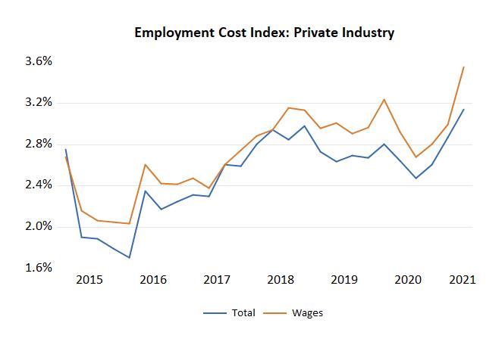
Industry Costs

Slide 19
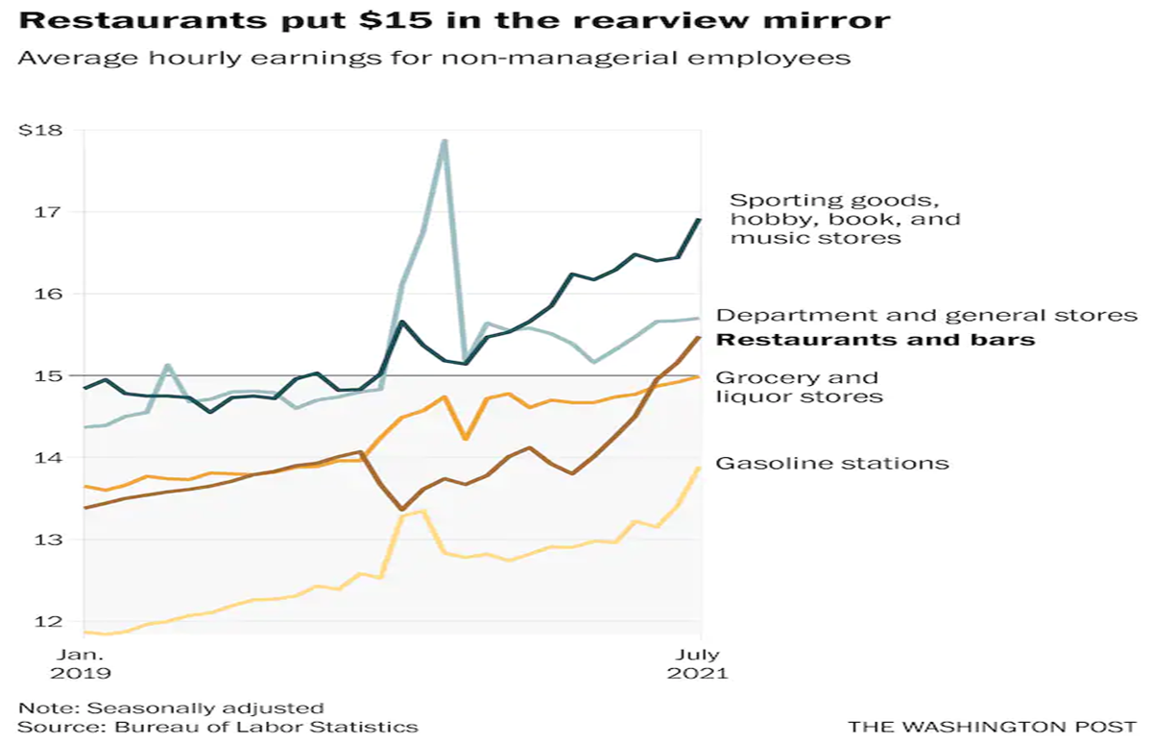
Wages

Slide 20
Industry Wages

Slide 22
Wisconsin’s Workforce Growth
22
Source: Bureau of Census, OEA

Slide 23
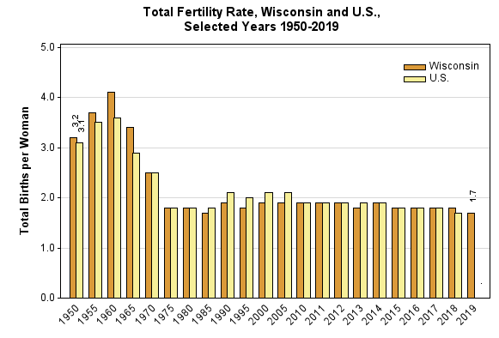
Fertility Rates
Source: Office of Health Informatics, Division of Public Health, Wisconsin Department of Health Services

Slide 24
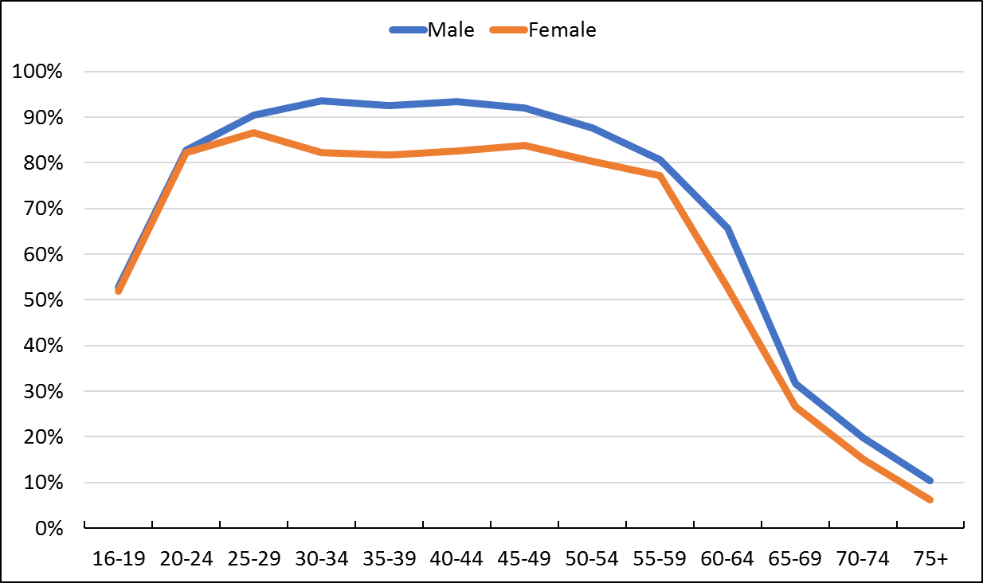
Labor Force Participation Rate by Age
Source: 2016 American Community Survey (ACS), US Census; sourced from IPUMS.org

Slide 25
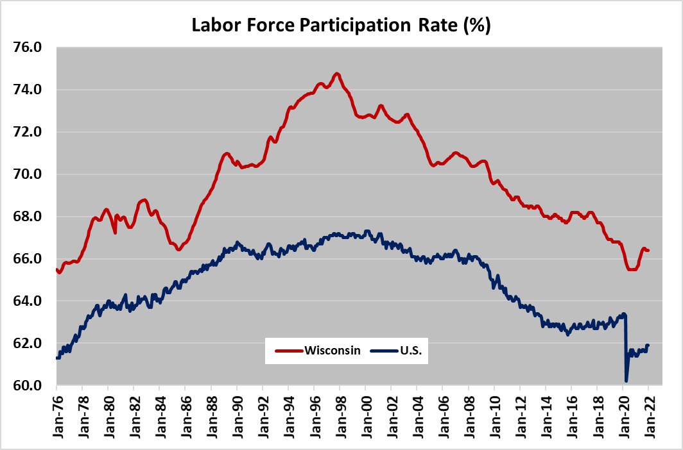
Labor Force Participation Rate by Age
Source: 2016 American Community Survey (ACS), US Census; sourced from IPUMS.org

Slide 26
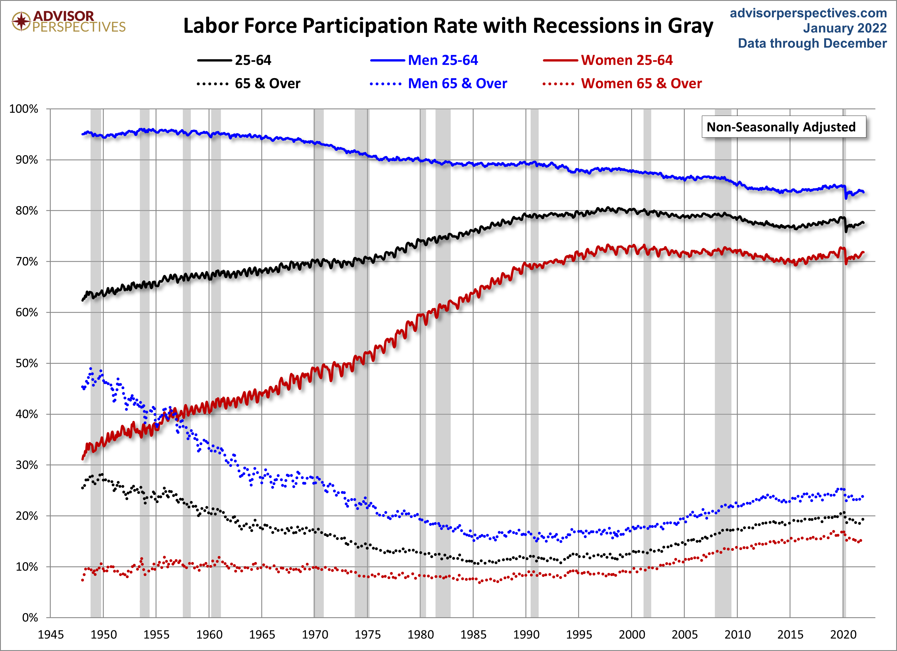
Labor Force Participation Rate by Age

Slide 27
Workforce
thousands
Source: CPS, 12-month average

Slide 28
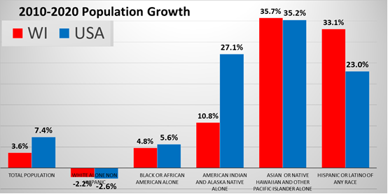
Population
Source: CPS, 12-month average

Slide 29
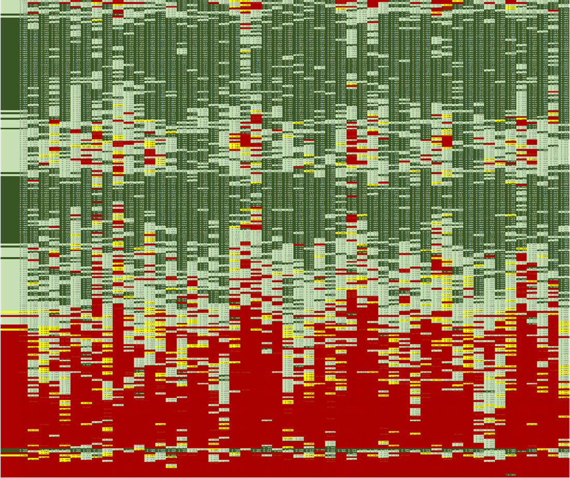
Workforce/Jobs Balance
Source: CPS, 12-month average

Slide 30
Four Solutions
Off-shoring
Immigration
Eliminate barriers of chronically unemployed
Technology
  Worker skills set must match
Buy American
  Willingness to pay higher prices

Slide 31
Im- & Migration
Source: US Census Bureau: National Population Totals and Components of Population Change: 2010-2019

Slide 32
Migration
State | Out of WI | Into WI | Net
Minnesota | 18,403 | 17,524 | -879
Illinois | 12,021 | 22,402 | 10,381
All US State Total | 101,668 | 107,973 | 6,305
Net IL |  |  | -4,076
IL and MN account for 29.9% of WI's domestic out-migration
IL and MN account for 37.0% of WI's domestic in-migration
Source: US Census Bureau; State-to-State Migration Flows, 2019

Slide 33
Lack of Childcare Access*
Source: US Census Bureau Household Pulse Survey
*Note: Categories are NOT mutually exclusive

Slide 34
Automation
There are two classes of jobs in the new age:
Those that are augmented by automation
Those that are replaced by automation

Slide 35
Propensity for Automation by Occupational Group
Source: The Future of Employment: How Susceptible are Jobs to Computerisation, C.B. Frey and M.A. Osborne, September 17, 2013, Oxford Martin School, University of Oxford; OES, OEA.

Slide 36
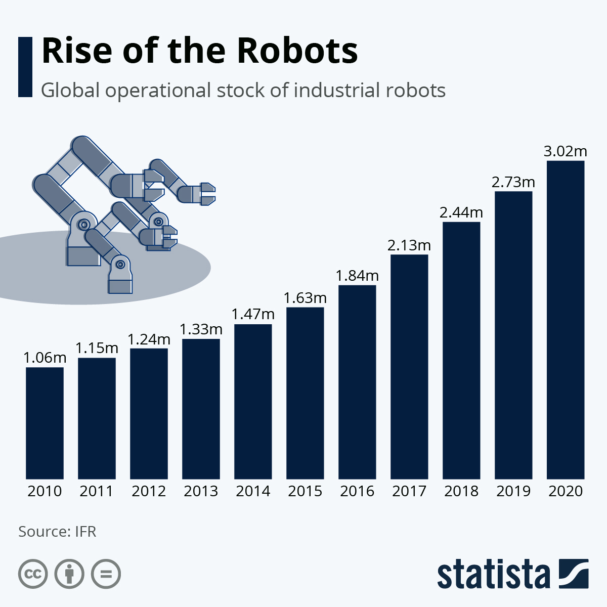

Slide 37
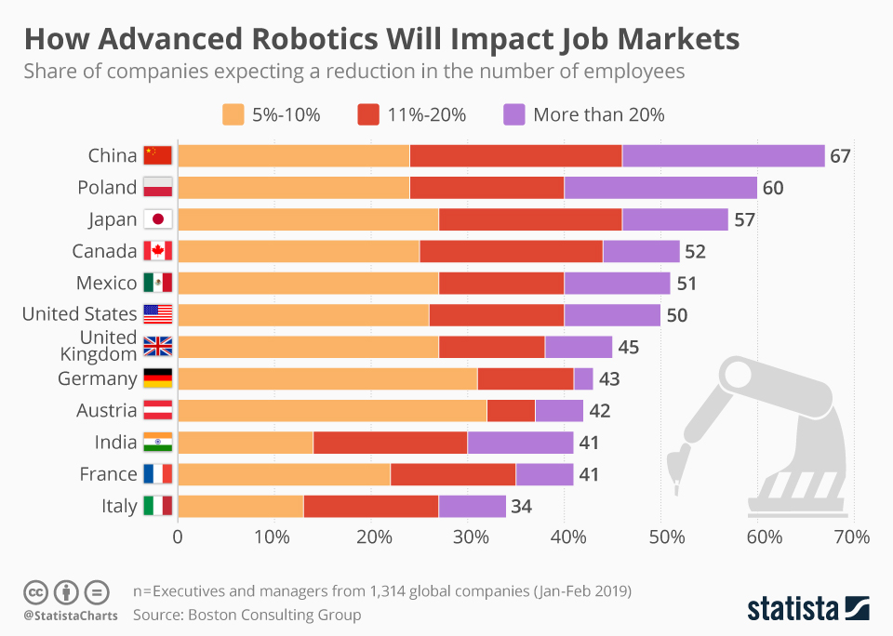

Slide 38
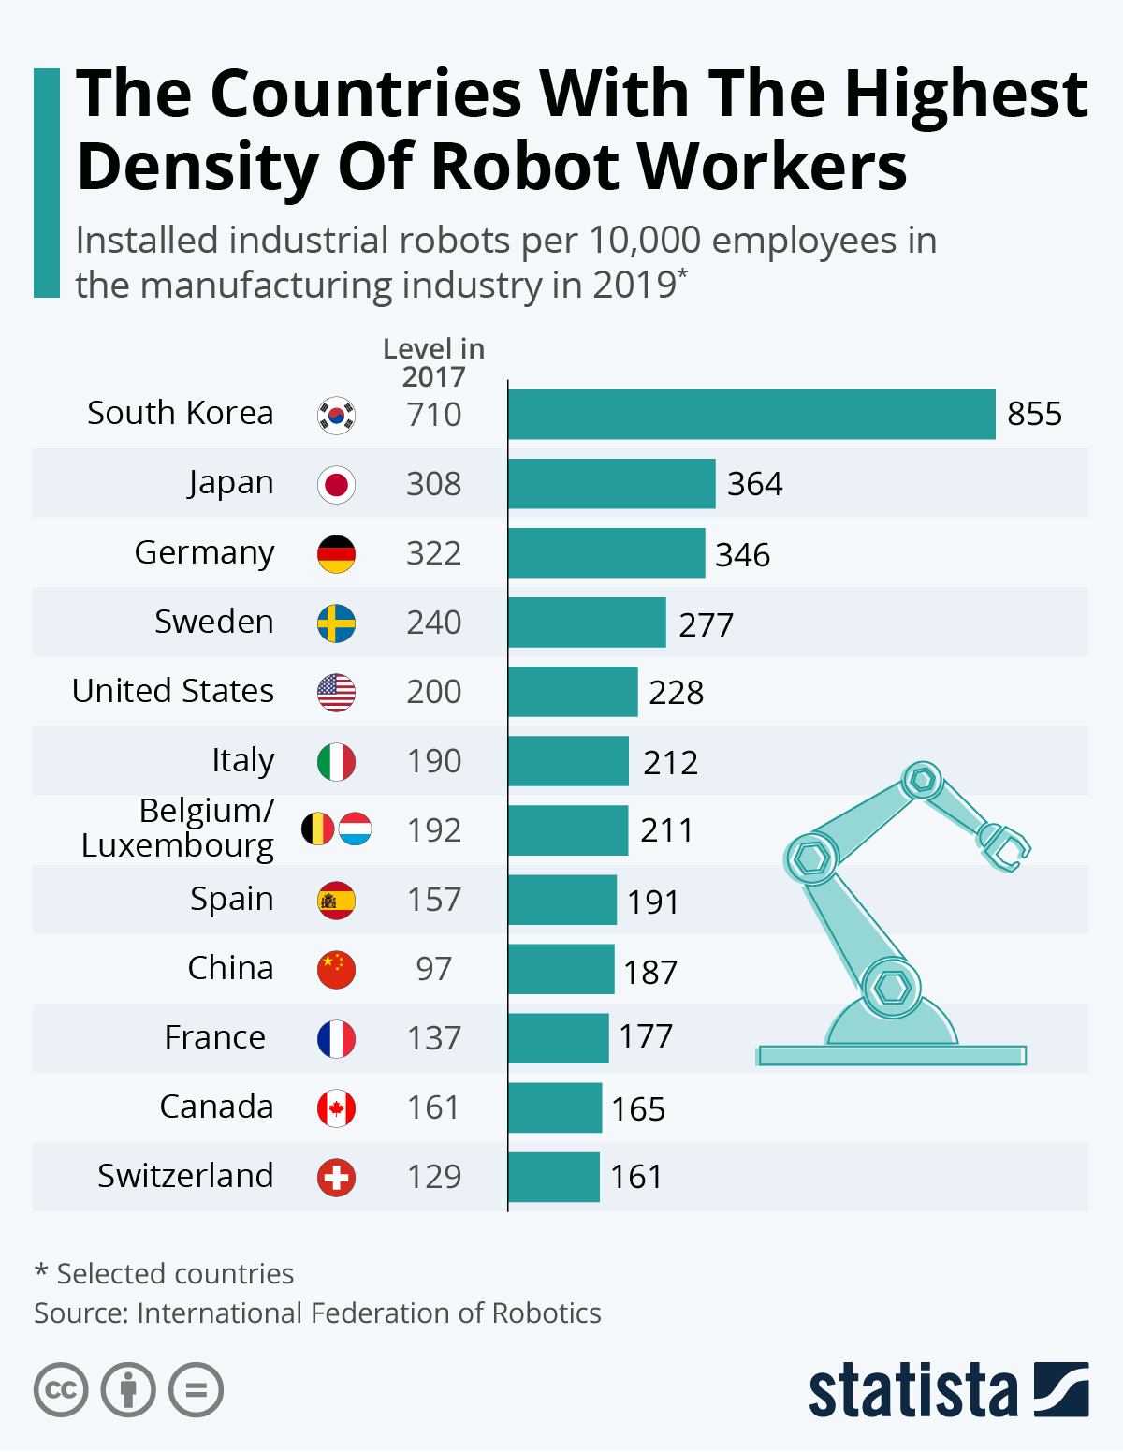

Slide 39
AI

Slide 40
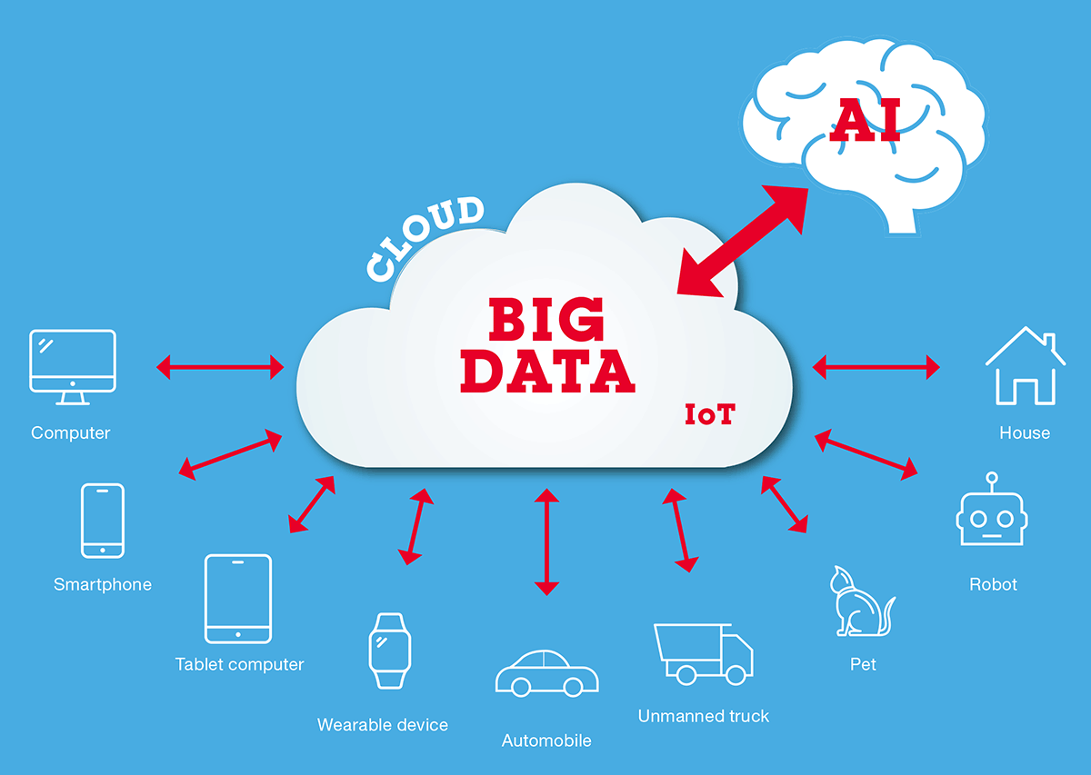

Slide 41
AI Skill Exposure
Source: Brookings analysis of Webb (2019)

Slide 42
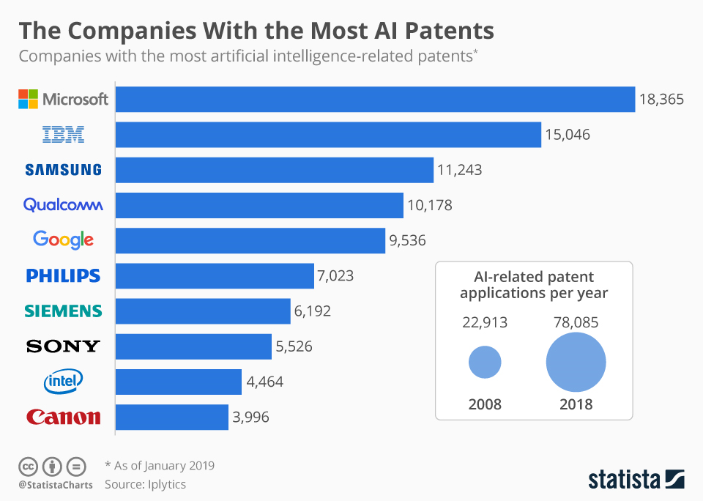

Slide 43
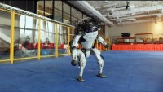
They’re Here

Slide 44
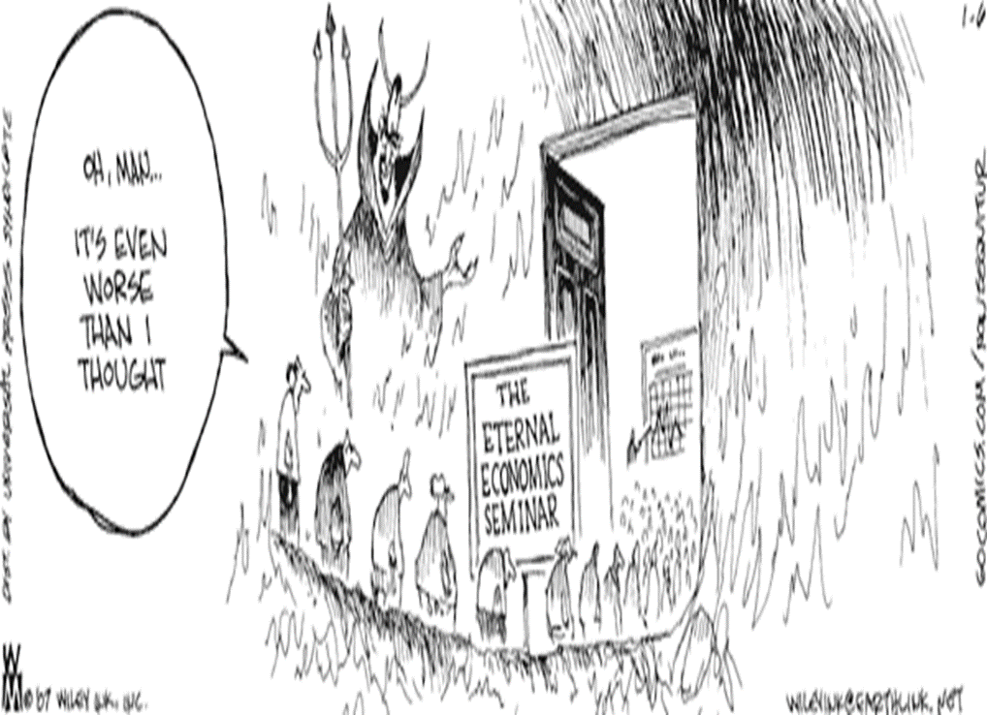

Slide 45
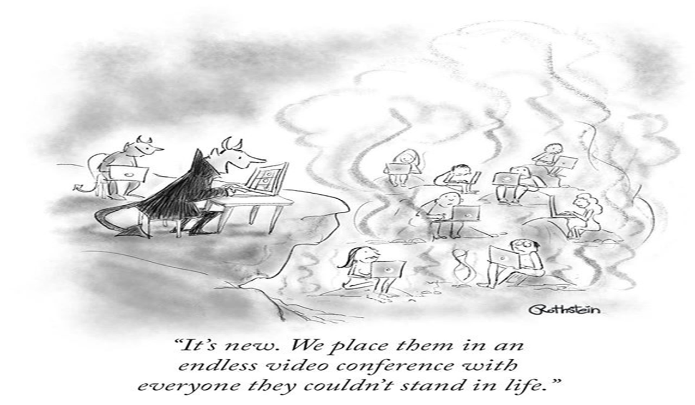
Be Careful

Slide 46
Questions?
DENNIS K. WINTERS
Chief Economist
Dennis.Winters@dwd.Wisconsin.gov

